Slide 1
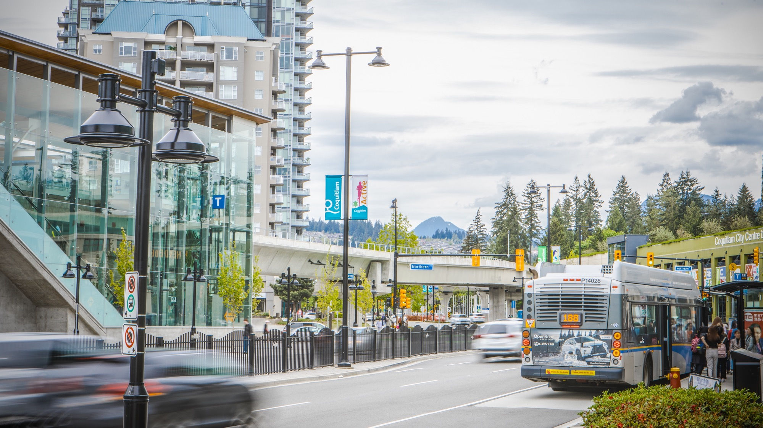

TextTransit
Delighting Customers and Empowering CIs
Amir MJ, Bo W, Camile M, Mirtha G & Sumit B
Transportation Policy and Planning
May 5, 2023

Slide 2


Did you know?
During the last ten-minute presentation,
our CI centre handled 20 calls!!!

Slide 3

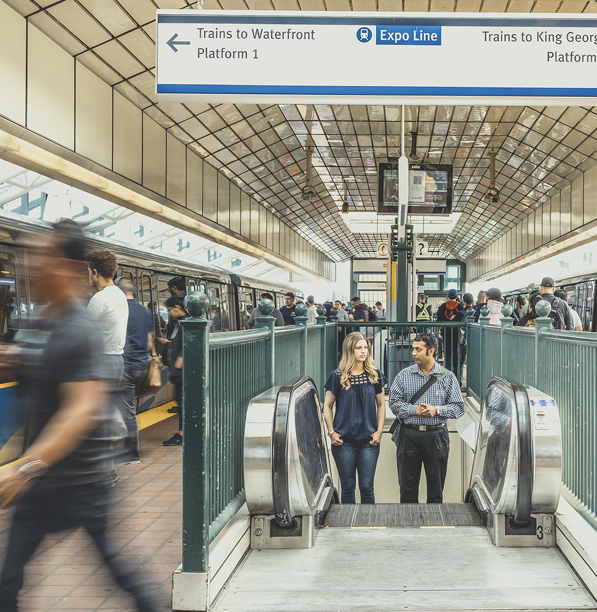






Media Relations/Comms
Front desk
Operations
Compass Call Centre
Customer Information Services
CI Call Centre
Other departments
Metro Vancouver
Website
Transit Police
Social Media
Notes:
We have consulted with both Compass Customer Centre and CI to understand how our customers communicate feedback, questions, or alerts to us.
For instance, a customer may have multiple inquiries. They may call Compass call centre to check their balance and ask other questions. The agent may need to look up their support documents or search on TransLink.ca for information. They may also need to forward the request to customer information services in case of alerts. Customer information then evaluates the situation, categorizes the request, and may need to send it to other TransLink departments and wait for replies…
As you can see…

Slide 4

It is overwhelming

Slide 5
Speed-up search; multilanguage support
Media Relations/Comms
Front desk
Operations
Compass Call Centre
Customer Information Services
CI Call Centre
Other departments
Metro Vancouver
Website
Transit Police
Social Media
Notes:
We have developed a solution that will enable us to deliver accurate, timely, and reliable information to our customers, simplify the process, and empower our front-end workers and customer information services. For example, our front desk will have access to a system with faster search engines.

Slide 6


Media Relations/Comms
Front desk
Speed up searches, call-to-text conversion
Operations
Compass Call Centre
Customer Information Services
CI Call Centre
Other departments
Metro Vancouver
Website
Transit Police
Social Media
Notes:
This system will provide call-to-text functionality, keyword highlighting, customer sentiment analysis, and quick searches for trip planning (which accounts for more than 90% of our calls).

Slide 7
Media Relations/Comms
Front desk
Operations
Compass Call Centre
Customer Information Services
CI Call Centre
Live chat that supports multiple languages
Other departments
Metro Vancouver
Website
Transit Police
Social Media
Notes:
Additionally, this system will enable a direct-to-customer feature on our website that will help them get fast answers. The system will search our website and other materials, such as T2050 and strategic documents, and return responses in seconds. This tool will also support multiple languages, fostering an inclusive way to serve our customers who speak English as a second language.

Slide 8
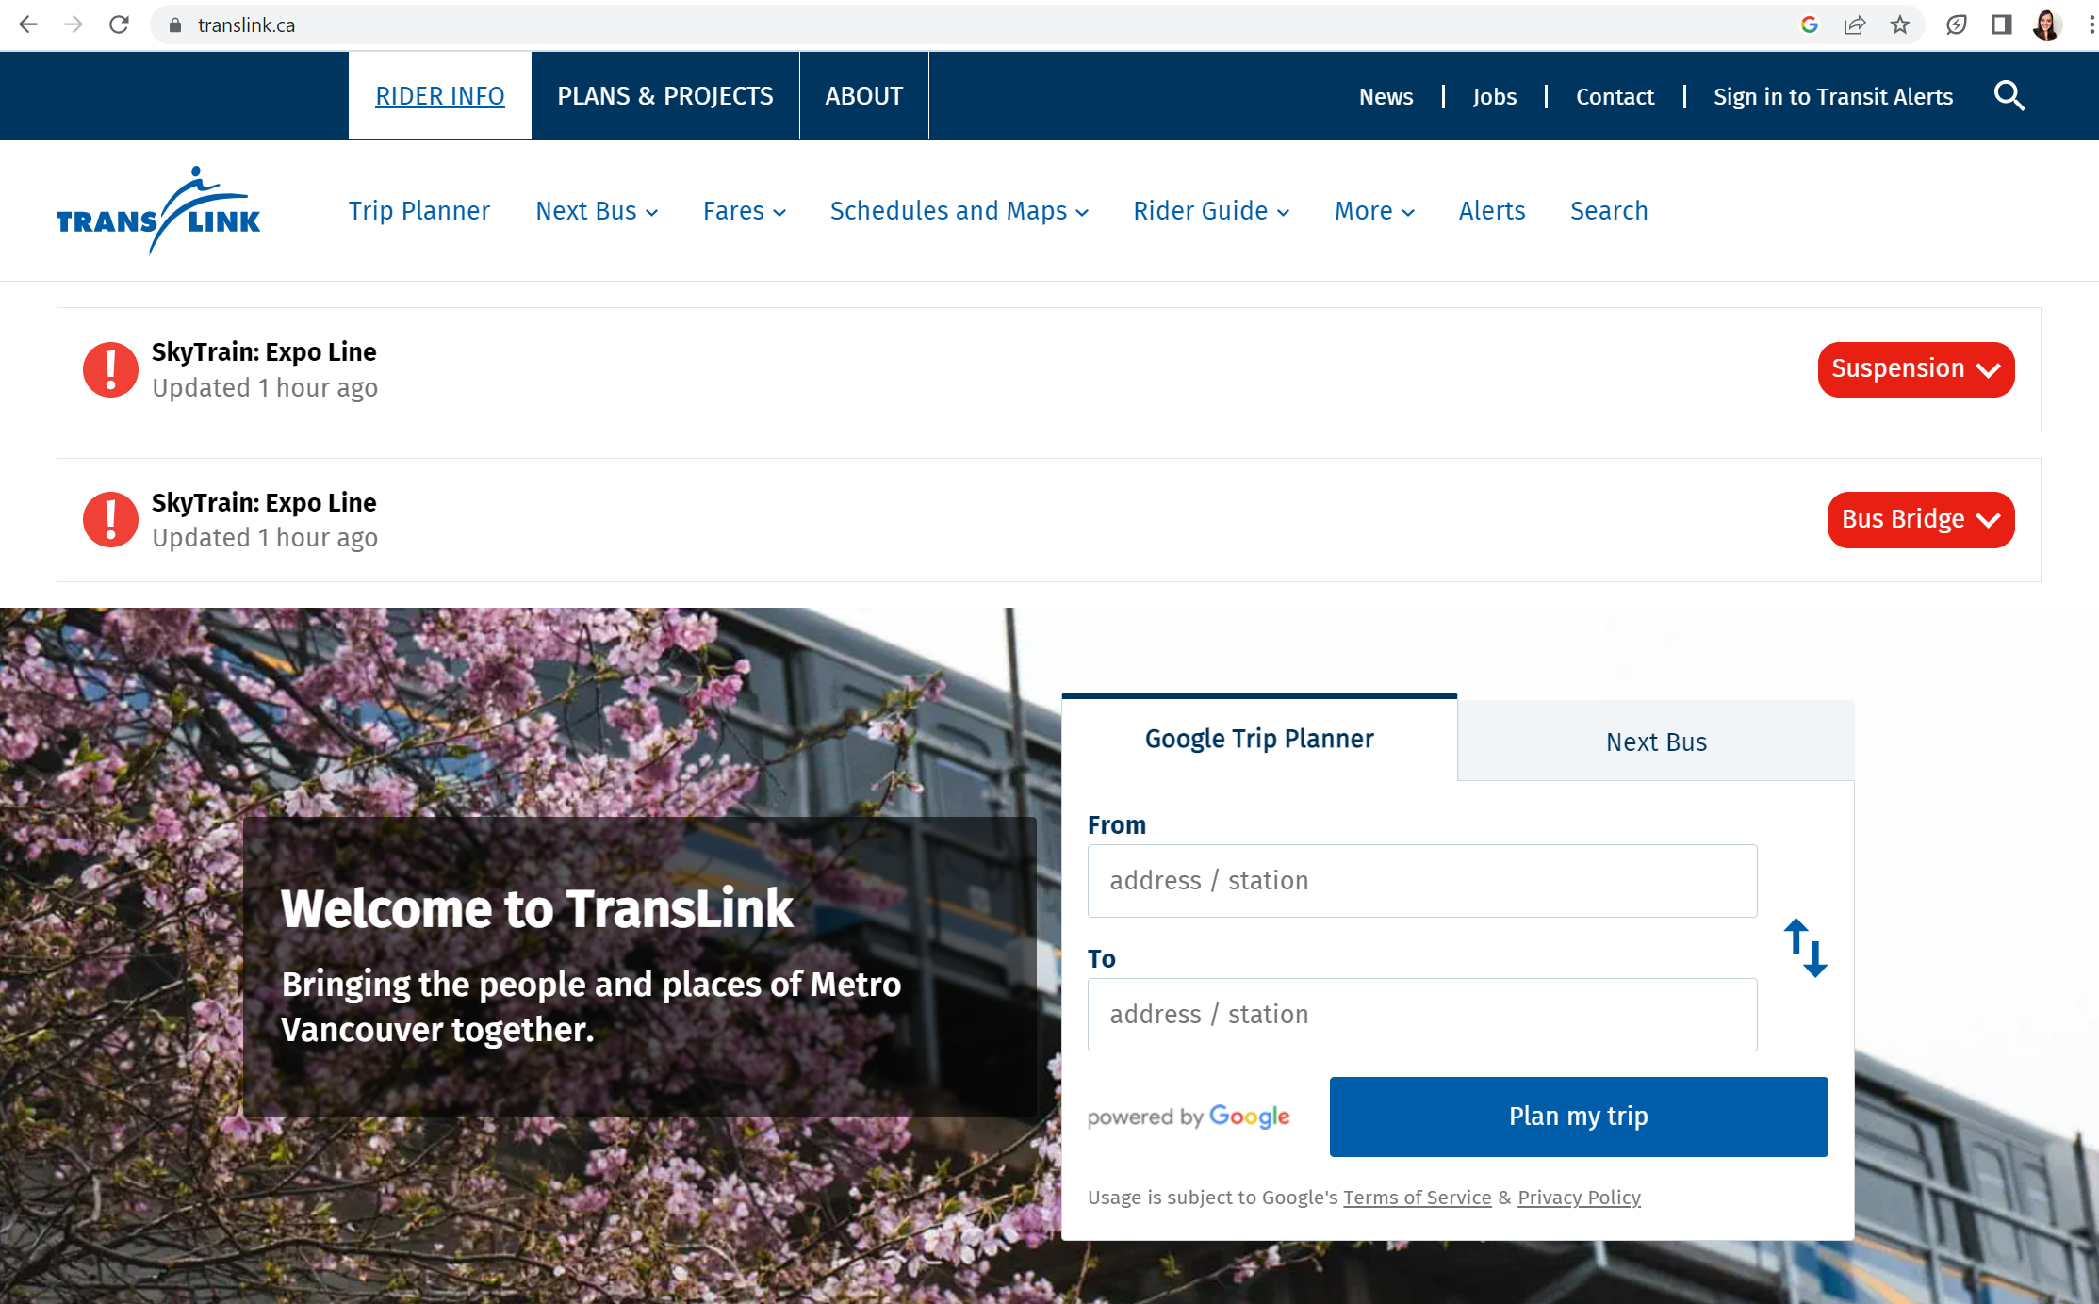

Introducing the new TextTransit
Ask real questions. Get support. Help us improve.
Notes:
And this is how it could look like. It is a simple way to assist our customers and CI staff in finding all the useful information we have on our website and official documents.

Slide 9
TAS will provide context (urgency, response), support languages, speed up searches, and propose routing
Media Relations/Comms
Front desk
Operations
Compass Call Centre
Customer Information Services
CI Call Centre
Other departments
Metro Vancouver
Website
Transit Police
Social Media
Notes:
Lastly, if the customer information services need to handle the request or feedback, it will include context, such as urgency, suggested response, and routing options for resolution.

Slide 10


Superpowers through AI
Notes:
To put it simply, we want to give CI access to all the information they need in one place and with one click.

Slide 11
Benefits
Enhance customer experience
Increase
efficiency
and
productivity​
Promotes Inclusion (ESL)
Improve first call resolution and other metrics
Notes:
To boost customer experience, CI efficiency, and productivity, while reducing stress and fostering inclusion.
With our proposal we can reduce customer response time by 20% and expedite requests like card balance and report stolen cards.
TAS facilitates multilingual support to promote equity and inclusion.
We can measure what matters to our customers by facilitating the analysis of requests and understand better the customer sentiment

Slide 12
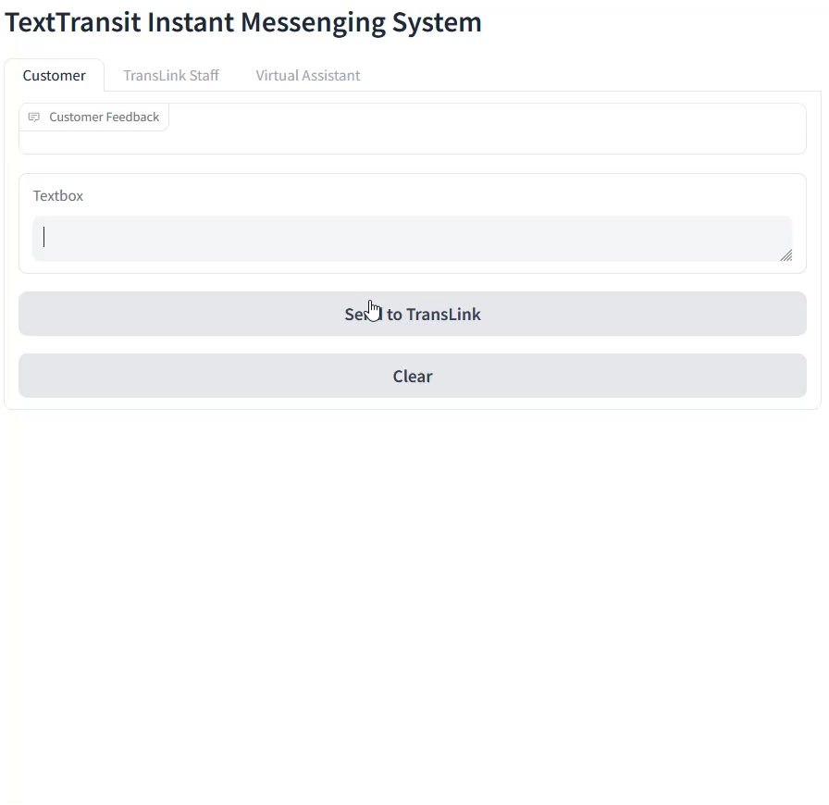
Notes:
One of the key pain point we identified during our research is that the CI support agent often know where to find the information, but it often take time to find the information and verify the sources. Our tool will provide a streamline approach for fact-finding and empower the CI support team and allow them to deliver the best customer service experience possible.
By empowering our Customer Information (CI) support team with the most relevant information in a timely and efficient manner, they will be able to create the best customer service experience to our customers from all channels.
We have a quick demo to demonstrate the core idea of our solution and how we can leverage the latest technologies using artificial intelligence with large language models to bring valuable information to our CI team.
I will first show a video of the demo, and then I will explain how each component works and how it can be integrated into existing business processes.
This demo is about a common theme related to how to pay for transit on our system, which is a frequent question both our CI and compass call centre receive.

Slide 13
Notes:
One of the key pain point we identified during our research is that the CI support agent often know where to find the information, but it often take time to find the information and verify the sources. Our tool will provide a streamline approach for fact-finding and empower the CI support team and allow them to deliver the best customer service experience possible.
By empowering our Customer Information (CI) support team with the most relevant information in a timely and efficient manner, they will be able to create the best customer service experience to our customers from all channels.
We have a quick demo to demonstrate the core idea of our solution and how we can leverage the latest technologies using artificial intelligence with large language models to bring valuable information to our CI team.
I will first show a video of the demo, and then I will explain how each component works and how it can be integrated into existing business processes.
This demo is about a common theme related to how to pay for transit on our system, which is a frequent question both our CI and compass call centre receive.

Slide 14
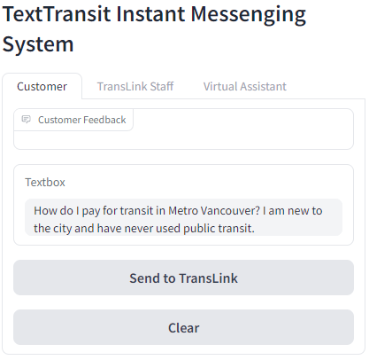
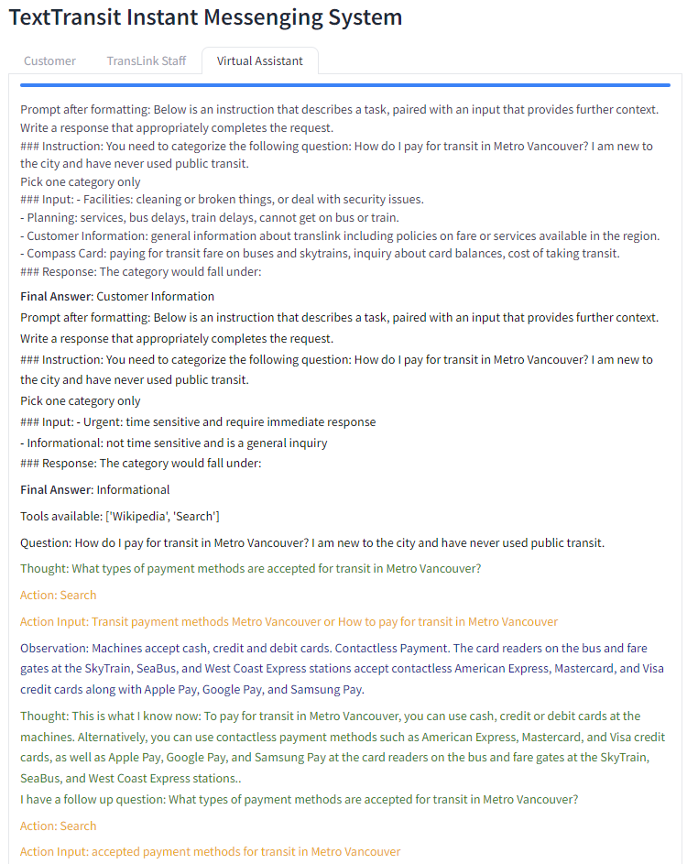
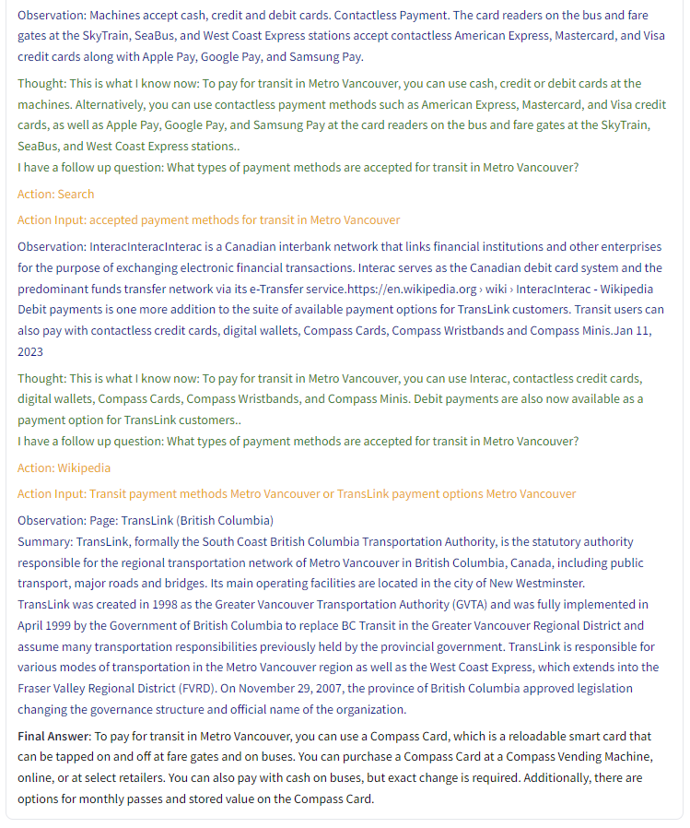
TextTransit
Notes:
When our customer submit an inquiry through our website, the TAS solution will delegate a virtual assistant to categorize the customer query into different categories and urgency, helping our customer support software to better prioritize customer requests.
Then, the TAS solution will search on various knowledge databases such as the web to obtain facts relevant to the customer’s question. Once TAS has obtained enough information, it will summarize the relevant information and provide that to our CI team.

Slide 15
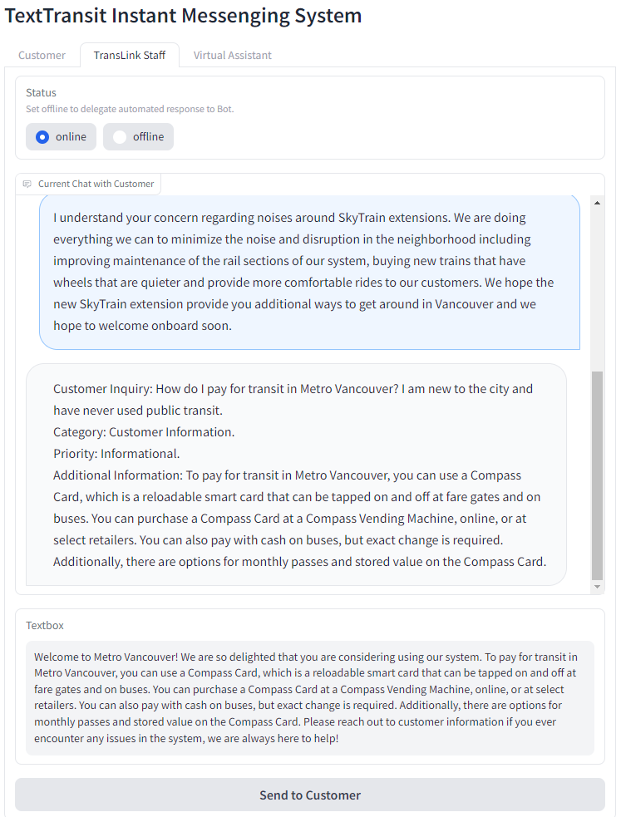
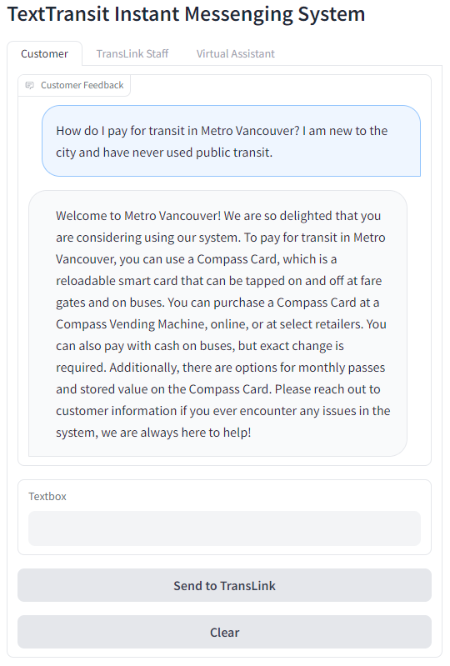
TextTransit
Notes:
By the time the customer’s question reaches the CI team, the CI team will have all the relevant information at the right level of detail ready to be served to our customer. Armed with the relevant and timely information, our CI team will be able to focus on providing excellent customer service experience.

Slide 16
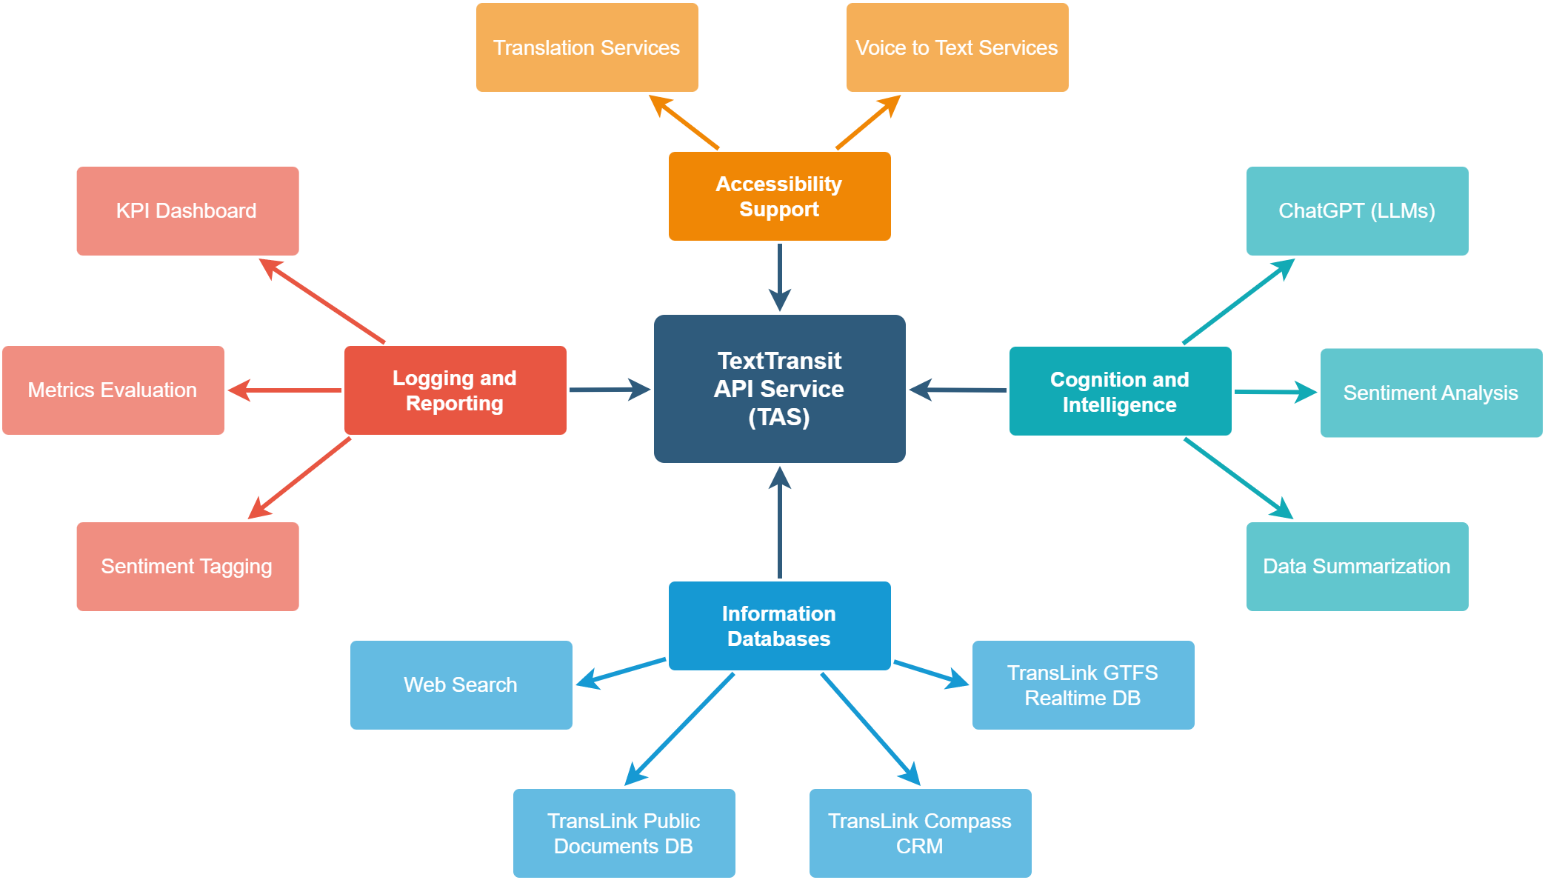
TextTransit Integrations
Notes:
The foundation of TAS is the information and knowledge databases consist of a variety of sources such as the web, our translink public documents, the compass card customer relations management software, and the translink GTFS information.
Armed with the strong foundation of authoritative facts, our TAS system can provide accurate data summarization and sentiment analysis to enhance the information our CI team has access to.
Moreover, the power of AI can enhance the accessibility of our communication channels with our customers by providing voice and text services as well as translation services on demand.
Finally, our TAS system can be used to perform metric evaluations and sentiment tagging to enhance CI team’s reporting capability, so management team can make informed decision regarding training and resourcing.

Slide 17
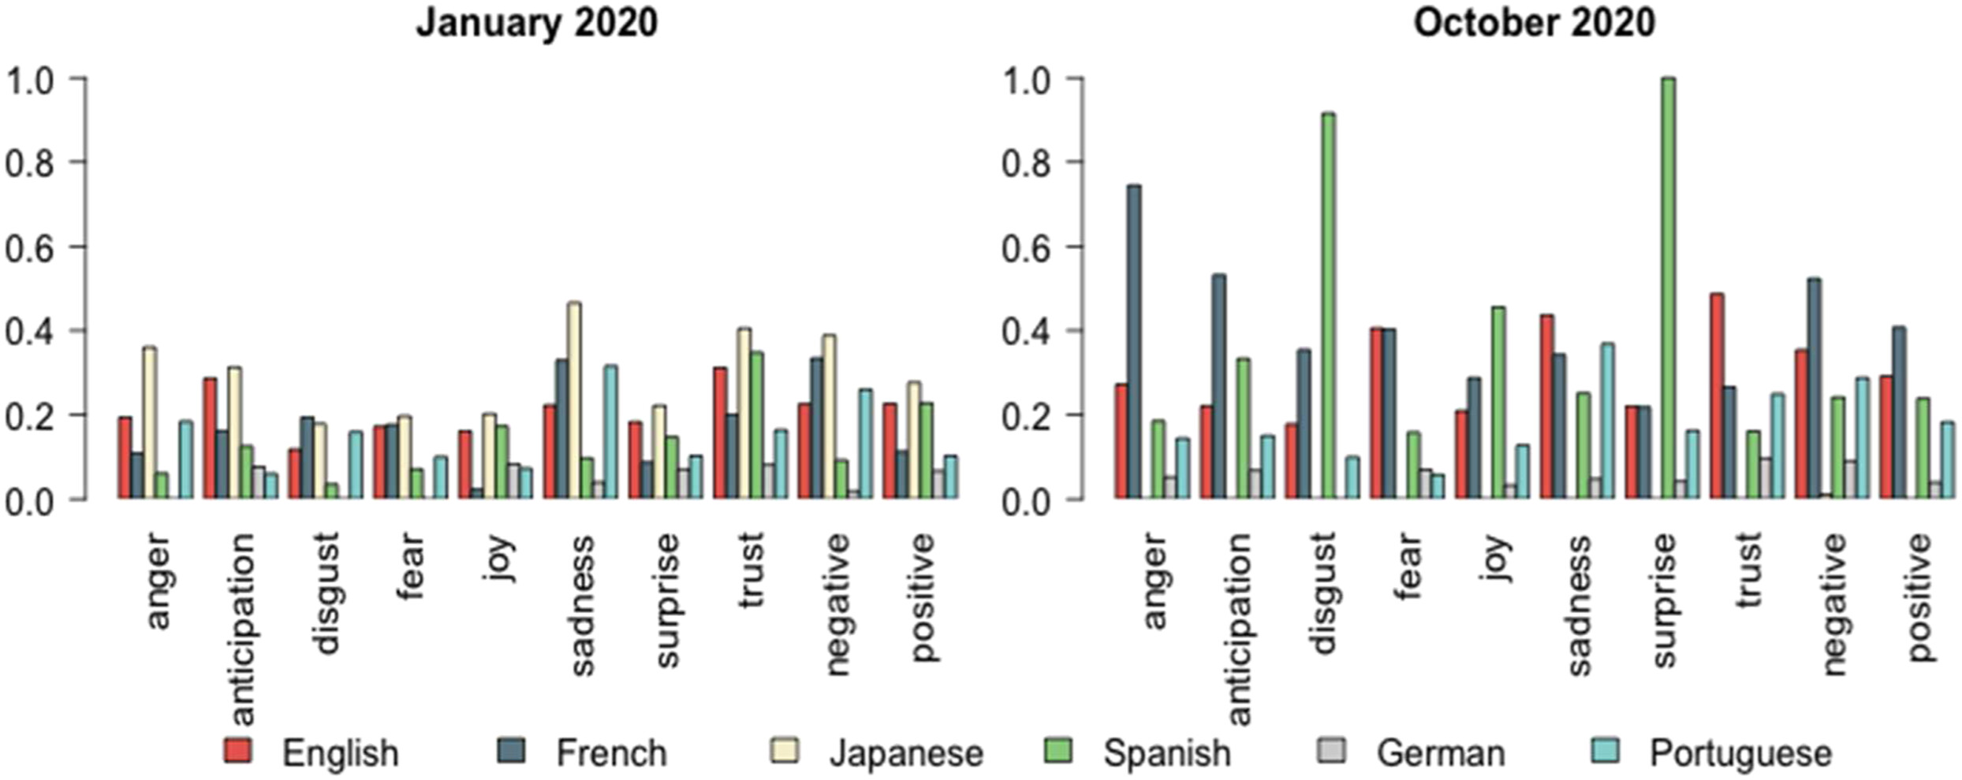
Sentiment Analysis
Source: Monitoring the well-being of vulnerable transit riders using machine learning based sentiment analysis and social media: Lessons from COVID-19 - Martino Tran, Christina Draeger, Xuerou Wang, Abbas Nikbakht, 2023 (sagepub.com)
Notes:
For reporting, we can provide sentiment analysis of our chat with the customer using LLMs. Giving our organization a deeper view of how we are interacting with our customers and how we can improve. It’s also a great way to evaluate whether our training exercises and business processes align with the goal of improving customer experiences.

Slide 18

CI Empowerment
Notes:
Our CI support team, operators and police are Translink’s face and voice. TAS will give our CI team the tools to provide an excellent transit experience when our customers need it.
We have a video of the demo, and it’s functional! If you are interested, we are happy to answer any questions about that as well.

Slide 19
Solution/Innovation
Large Language Model - OpenAI API
Databases - Cosmos DB (nosql database backend store)
Data summarization - Cognitive Services (reads website into a document and it goes into storage account)
Sentiment Analysis - Cognitive Services (summarizing speech to text)
Bot Creation - Power Platform (low code platform .... information funnels ... power app using QR code or website .. can be used with customer info team)
Enhanced Power BI - Analyze data to make future business decision
Cognitive Services - Realtime sentiment analysis of phone calls coming in

Slide 20
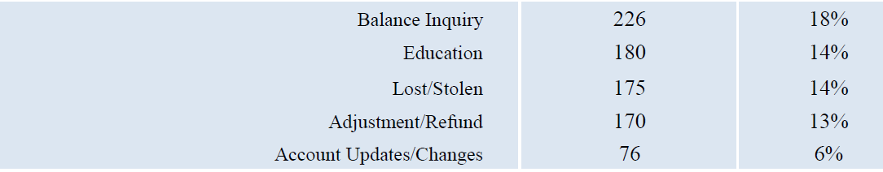

Slide 21



Public
Media Relations/Comms
BOT
Operations
BOT
BOT
Customer Information Services
Other departments
Transit Police
Customer information/request is sent with urgency level

Slide 22
Solution/Innovation
Integrate the different web-based/email channels of communication
Customer experience improvement
Enhance the customer experience by improving response times (resolution time)
Later phases:
Improve and simplify access to information
Analyze and classify inquiries and complaints
BENEFIT: CENTER OF TRUTH CONTAINING ALL COMPLAINS
Notes:
Translation Services

Slide 23
Media Relations/Comms
Front desk
Operations
Compass Call Centre
Customer Information Services
CI Call Centre
Other departments
Metro Vancouver
Website
Transit Police
Social Media

Slide 24

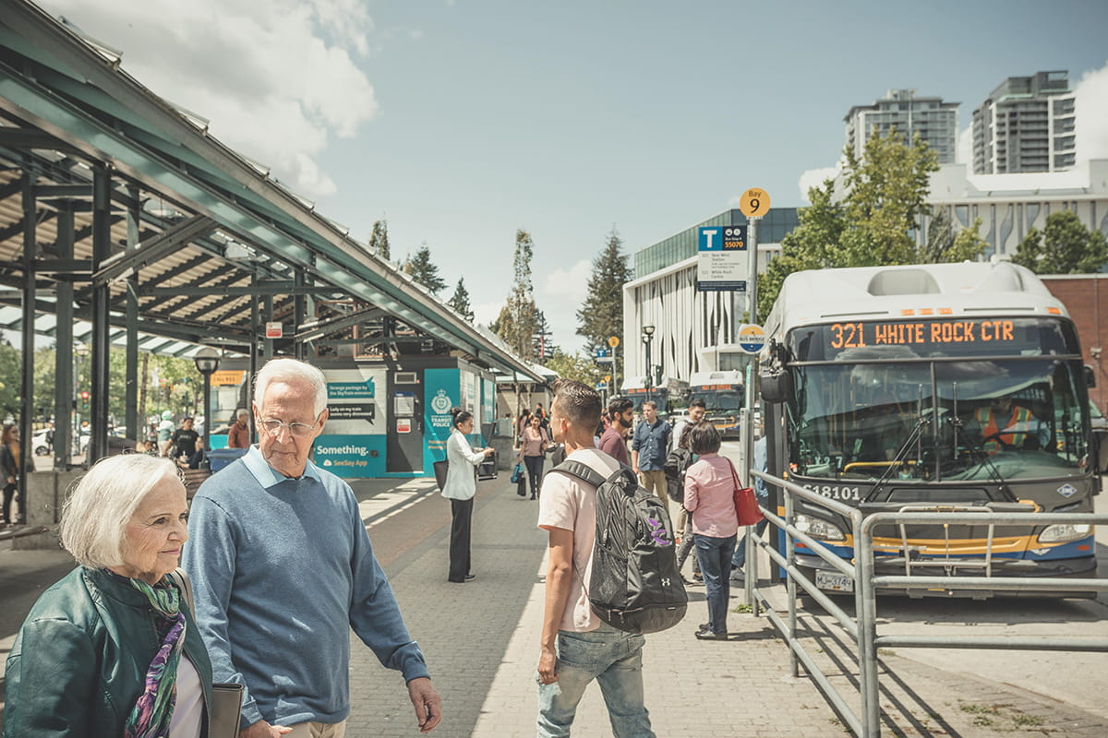
Media Relations/Comms
Operations
Customer Information Services
Customer Information Services
Other departments
Transit Police

Slide 25
Public
Media Relations/Comms
Operations
Customer Information Services
Other departments
Transit Police

Slide 26
Resources

Slide 27
Business Value
By providing additional context we can:
Reduce customer response time by 20%,
Average call duration are currently 2min30sec and they could be reduced by 2 minutes
Efficiently provide information like card balance, report stolen cards
Offer multilingual support that promotes equity and inclusion
We can measure what matters to our customers by:
Increasing customer satisfaction
Measuring customer sentiment

Slide 28
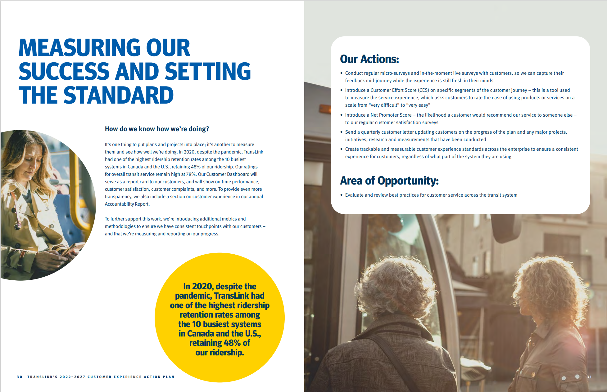
Notes:
Important wording and framing: The more we appreciate and acknowledge our customers’ unique needs and desires, the more we can create infrastructure, services, programs, and amenities that serve them better.
New to this plan is a further dedication to customer experience, including the creation of a new team with a dedicated budget that will focus on resolving customer issues, compiling customer metrics for distribution across the enterprise, and ensuring that TransLink is transparent with all of the decisions we are making around the customer experience.
Every decision we make – planning, investing, delivering our services is done with the customer in mind.
Dug even deeper into how we can better understand our customers. We have taken deliberate, measured steps to gain a more nuanced understanding of our customers, including travel behaviours, pain points, decision drivers, and moments that matter. With these insights, we can better prioritize our projects, initiatives, and investments that directly address our customers’ wants and needs. Our customers are one of our best sources for insight and feedback. They’re the linchpin in identifying opportunities that go above and beyond to deliver a better transit experience.
Safe and Pleasant: Actions: Develop a Customer Urgent Response Team during any major disruptions or delays
Areas of opportunity- Offer cleanliness and maintenance QR codes and/or a hotline for customers and employees to inform TransLink about cleaning or other maintenance required across the system

Slide 29
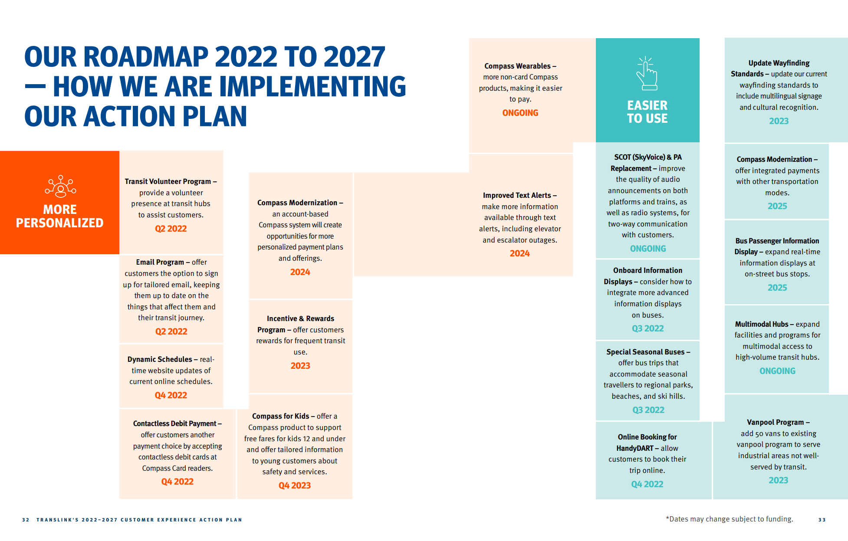
Land Acknowledgement
Notes:
Important wording and framing: The more we appreciate and acknowledge our customers’ unique needs and desires, the more we can create infrastructure, services, programs, and amenities that serve them better.
New to this plan is a further dedication to customer experience, including the creation of a new team with a dedicated budget that will focus on resolving customer issues, compiling customer metrics for distribution across the enterprise, and ensuring that TransLink is transparent with all of the decisions we are making around the customer experience.
Every decision we make – planning, investing, delivering our services is done with the customer in mind.
Dug even deeper into how we can better understand our customers. We have taken deliberate, measured steps to gain a more nuanced understanding of our customers, including travel behaviours, pain points, decision drivers, and moments that matter. With these insights, we can better prioritize our projects, initiatives, and investments that directly address our customers’ wants and needs. Our customers are one of our best sources for insight and feedback. They’re the linchpin in identifying opportunities that go above and beyond to deliver a better transit experience.
Safe and Pleasant: Actions: Develop a Customer Urgent Response Team during any major disruptions or delays
Areas of opportunity- Offer cleanliness and maintenance QR codes and/or a hotline for customers and employees to inform TransLink about cleaning or other maintenance required across the system

Slide 30
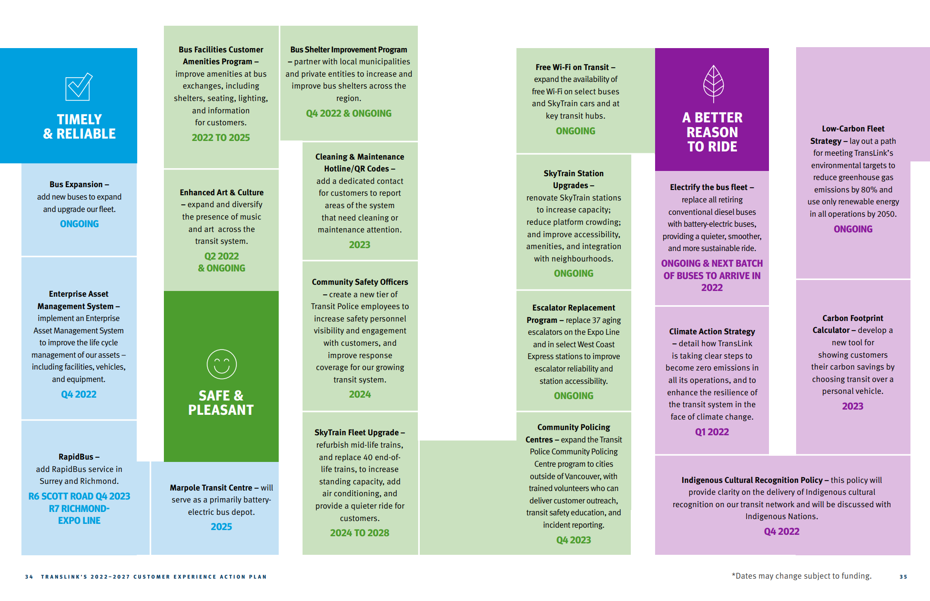
Land Acknowledgement
Notes:
And it doesn’t stop there – we will continue to listen to what you, our customers, have to say, and we will use your valuable insight to fnd ways to improve our system while keeping you in the loop every step of the way. We know the importance of being transparent with the work we are doing and we will report back on our progress while being open and honest with you on what is working and what we’re still trying to improve.

Slide 31
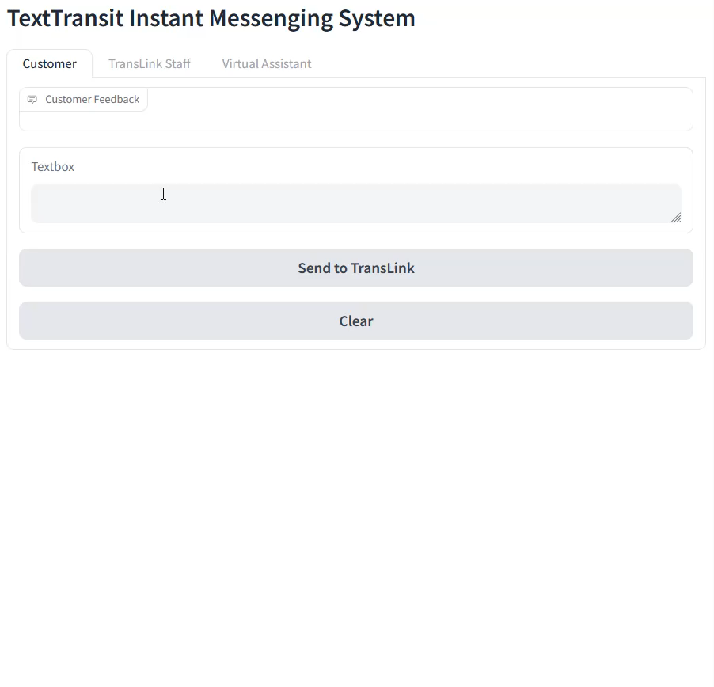

Slide 32
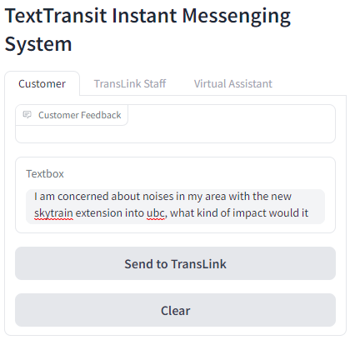
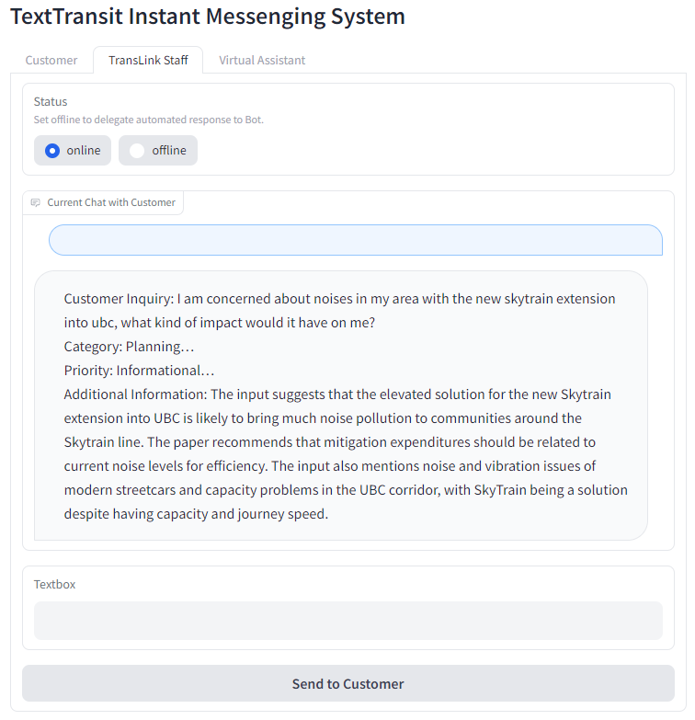
TextTransit
Notes:
Bo

Slide 33
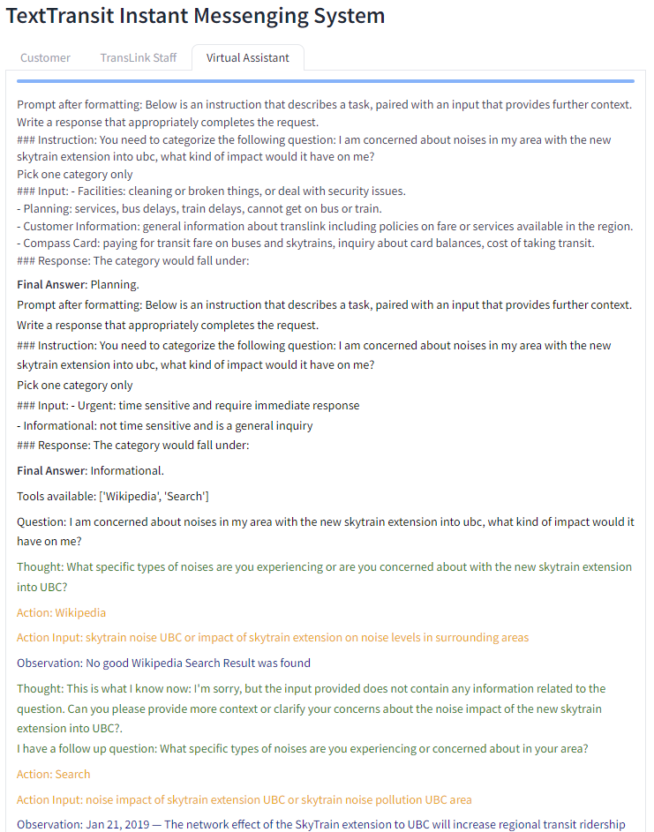
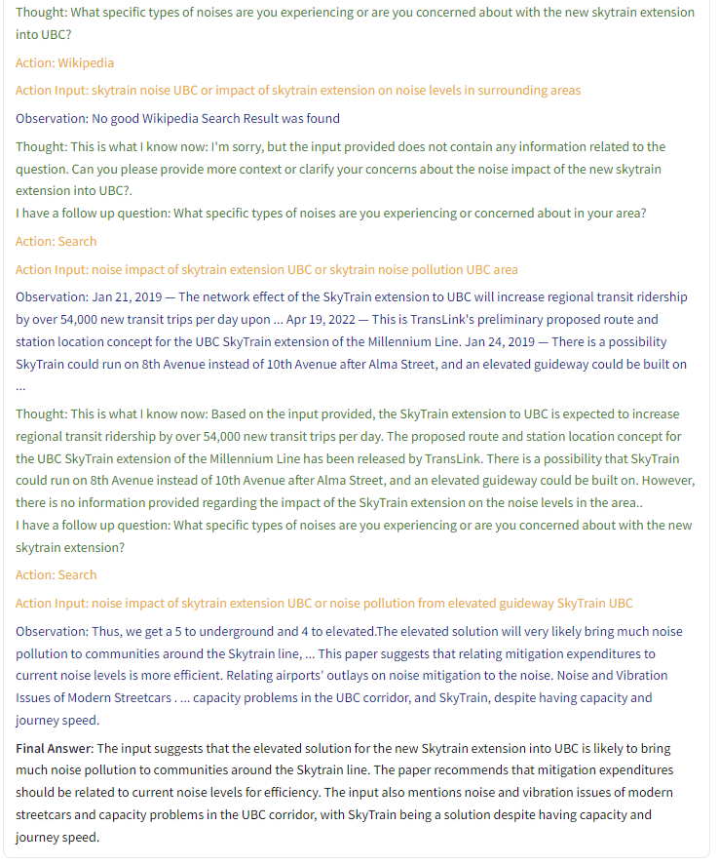
TextTransit
Notes:
Bo

Slide 34
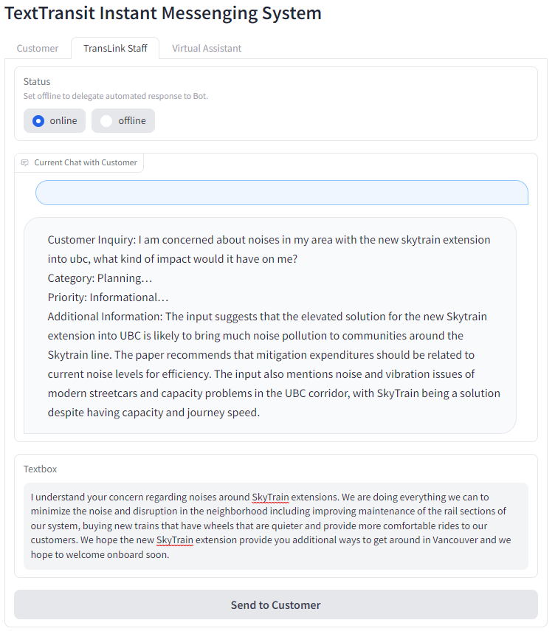
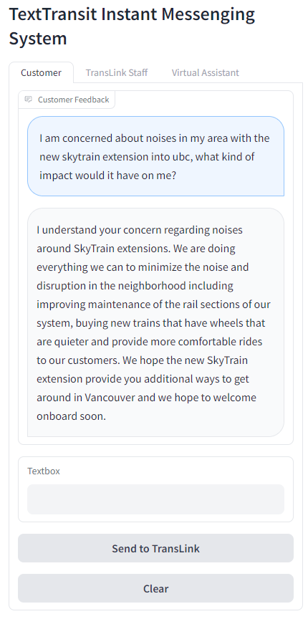
TextTransit
Notes:
Bo

